Slide 1
Redwood & FreightWaves
Charlie Marshall
Aarij Rehman

Slide 2
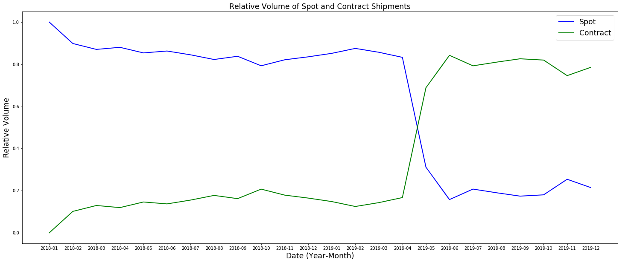
Relative Volume of Spot and Contract Rates
Notes:
Question 4
This graph shows the relative frequency of shipments conducted at contract rates and spot rates in 2018 and 2019. In 2019, it’s clear there was a massive shift where contract rates were being used more. This was a result of various factors, but the biggest being expansion in 2017 and 2018 led carriers to over prepare for 2019. When demand wasn’t what it was expected to be, the surplus of shipping services available drew spot prices down, leading to carriers accepting contract rates over taking spot rates.
Essentially, a large shift in supply from increases in available supply and available truckers drew prices down, which is in part why 2019 was a particularly difficult year for truckers.

Slide 3

Notes:
In general, it’s helpful to understand what types of features determine whether a shipper will sign a forward looking rates contract versus relying on the spot market. A contract rate helps shippers avoid risk that can arise from things like international trading patterns, weather, and even global pandemics - more on that last one soon. Shippers will prefer spot rates when market conditions lead to lower prices, but the consistency and reduced risk of contract rates often convinces shippers to agree to forward-looking deals.

Slide 4

Notes:
One such example of an external factor that could influence rates is global trading patterns. For example the recent trade wars with China saw reduced demand for truckers by west coast ports. This is something entirely uncontrollable and largely unpredictable for both shippers and carriers. Something like this essentially drives demand lower and therefore drives rates lower, which may lead to a shipper accepting market rates as opposed to signing forward looking contracts.

Slide 5

COVID-19 and the Shipping Industry
Notes:
Even more relevant, with the recent coronavirus pandemic, the american economy has suffered. Companies are laying off workers, and entire industries are becoming unnecessary. That being said, panic buying has led to the trucking industry seeing unprecedented volume. Shelves need to be restocked and consumers are demanding staples now more than ever. The spike in the Outbound Tender Volume Index is accompanied by a similar spike in Outbound Tender Rejects, indicating drivers are rejecting contract loads for the higher spot rates.
Now, with this increased demand, it may seem carriers should increase supply to capture available profits, but as 2019 showed, that isn’t always the best solution. Similarly, shippers may be tempted to sign contracts to get a hold on prices, but we strongly believe they should deal with the higher rates while they last. As companies go out of business and the public calms down, rates will return to where they were or even below. Signing a forward looking contract, especially a year long one, might alleviate fears in the short term, but will likely eat into profit down the line.

Slide 6

FreightWaves External Factors
Notes:
Question 5
But, regardless of what rates are at, shipper may want to understand how rates can change.
We ran various regression models to come up with what we felt were the most meaningful external factors to predict 2020 shipping rates. However, as we’ve mentioned, the Coronavirus has arguably altered a lot of what we can say about 2020, but our analysis is still valid from a more general perspective.
Here, we’re going to discuss one macro factor, one local factor, and one lane specific factor - allowing us to show how each of these contributes differently to shipping rates.

Slide 7
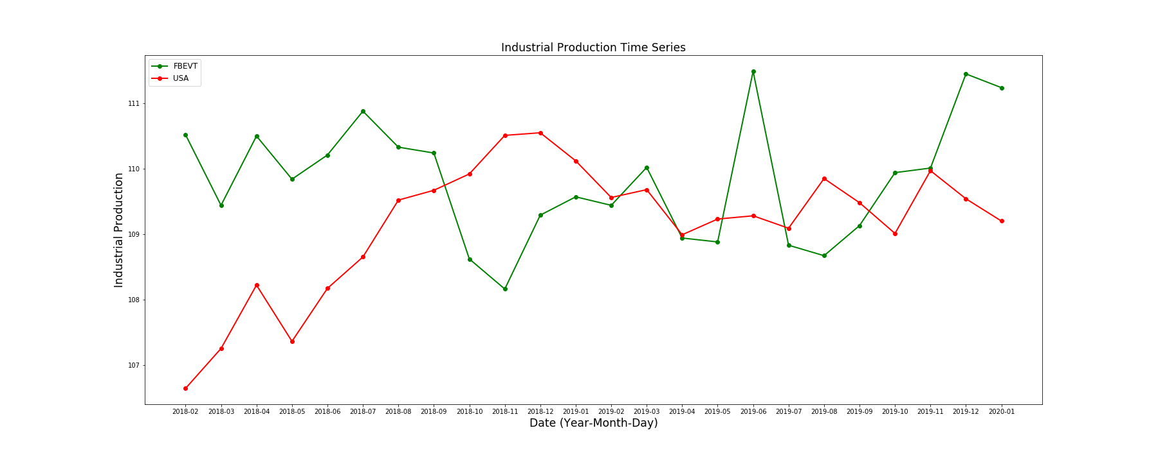
IPRO.USA
Notes:
The most meaningful macro factor is the IPRO index. The IPRO index is a monthly measure of industrial production, and IPRO.USA indicates we’re looking at total production.

Slide 8

Notes:
Since manufacturing accounts for about 75% of the total industrial output in the US, it’s clear why this index is so important in predicting rates. When industrial production increases, we expect demand for freight services to increase as well - resulting in higher rates. Ultimately, we think the IPRO index is a great indicator of where rates are going for any shipment, and it can be useful for predicting future movements.

Slide 9
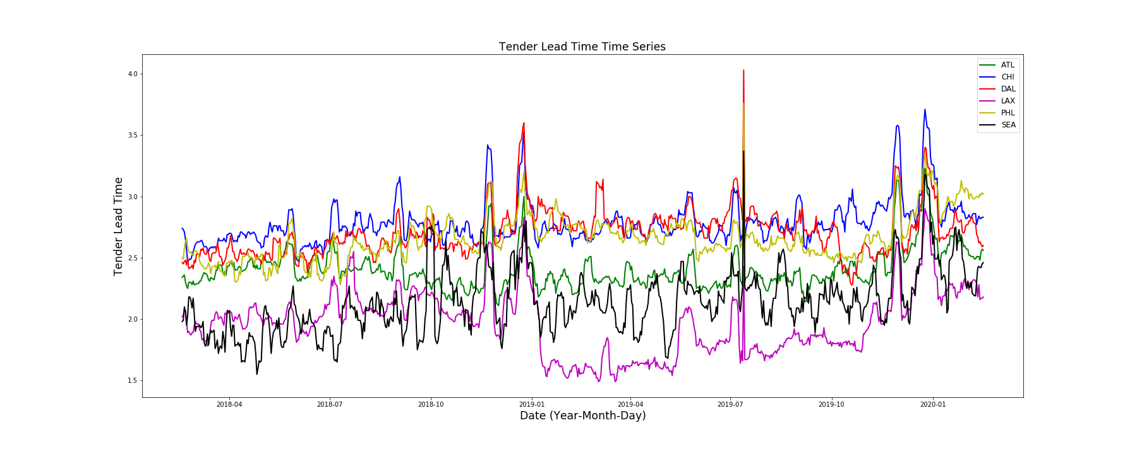
TLT
Notes:
The most meaning local factor is the TLT index, which stands for Tender Lead Time, which measures the length of time between a load being offered and the requested pickup date for that load. We can generally categorize the changes in TLT into two interpretations. When lead times increase, that generally means the companies shipping products are having capacity issues, and when lead times decrease that means these companies have unexpected surging volumes.

Slide 10

Notes:
When lead times are high, carriers have more time to fit shipments in their schedule, and it makes sense to offer lower rates. Similarly, when lead times are low, rates are higher because it’s analogous to higher demand (shippers need to move product quicker).
Another thing we found that was interesting is when carriers have at least 48 hours of lead time, they are less likely to reject loads. This makes sense because they’re more likely to be able to schedule those loads in. From a shipper’s perspective, it’s beneficial to give carriers more lead time to help reduce rates.

Slide 11
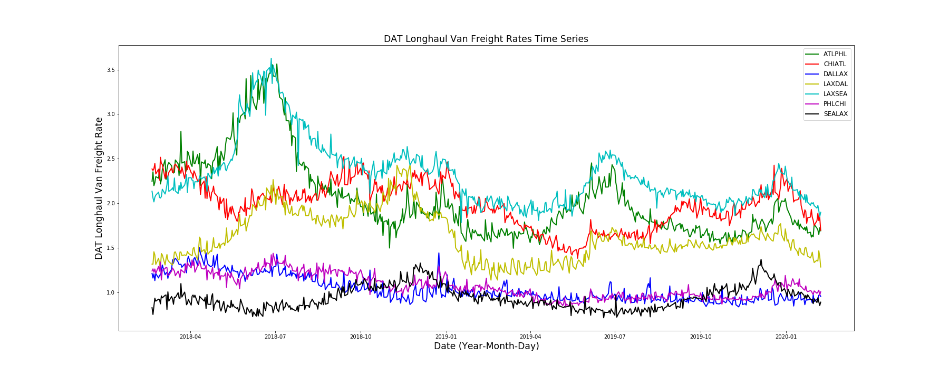
DATVF
Notes:
The most meaningful lane factor, perhaps unsurprisingly, is the DATVF index. This index tracks average rates for the seven Freight Future Lanes. Perhaps it’s a bit obvious that this index is one of the most meaningful, it’s important to still discuss it. When you have an abundance of data and data analytics tools, it’s easy to ignore some of the most straightforward metrics, and using past performance on these Future Lanes offers some of the most meaningful instruction as to where future prices are headed.

Slide 12
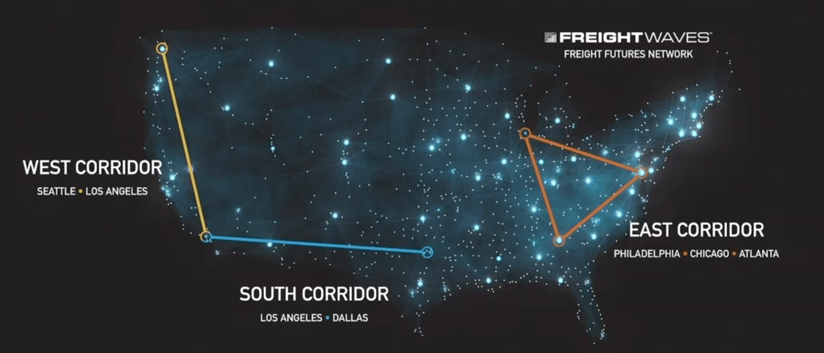
Notes:
Although in finance people often say past performance doesn’t determine future performance, it would be naive to not at least consider past performance. Specifically, here, the fact our analysis showed the DAT Van Freight Index to be a strong predictor means that we don’t see huge deviations from day to day on average rates, suggesting we can use previous rates to determine future rates.

Slide 13

Notes:
Question 6
After exploring the data, we found various other elements of interest. Using the given data, when we tried to build models for predicting future rates, it was a lot harder to predict those rates for shorter distance trips, specifically, trips that were 100 miles or less. Essentially, if shippers are interested in minimizing their risks, they should avoid shipping multiple times in short distances and instead ship fewer times long distance. Obviously this isn’t always possible, and in the case where shipping short distances is unavoidable, we think it’s very helpful to sign forward looking contracts for these types of deliveries.

Slide 14

Notes:
The power of rate prediction based on distance for carriers and shippers.
Insights for Carriers:
Our models allow a carrier to predict the rates for certain distances relatively well given FreightWaves indexes. If a carrier sees that a certain distance will predicts to have better rates relative to other distances (i.e. short shipping as opposed to long shipping), then they should concentrate more of their fleet on this distance of shipping to see higher profits.
Insights for Shippers:
A shipper can utilize the predictive abilities of our model to compare a contract or spot rate that they might sign and see how it stacks up against predicted prices. The power to for a shipper to predict rates based on market conditions allows them to not give away a piece of work for under the actual parket price.

